Slide 1
Hands on Venn Diagram
Heather List

Slide 2
Objective
Create Venn Diagrams using animals and different characteristics.
Helps students more clearly see the differences and similarities in sets
Helps to teach union, intersection and the formulas for Venn Diagrams

Slide 3
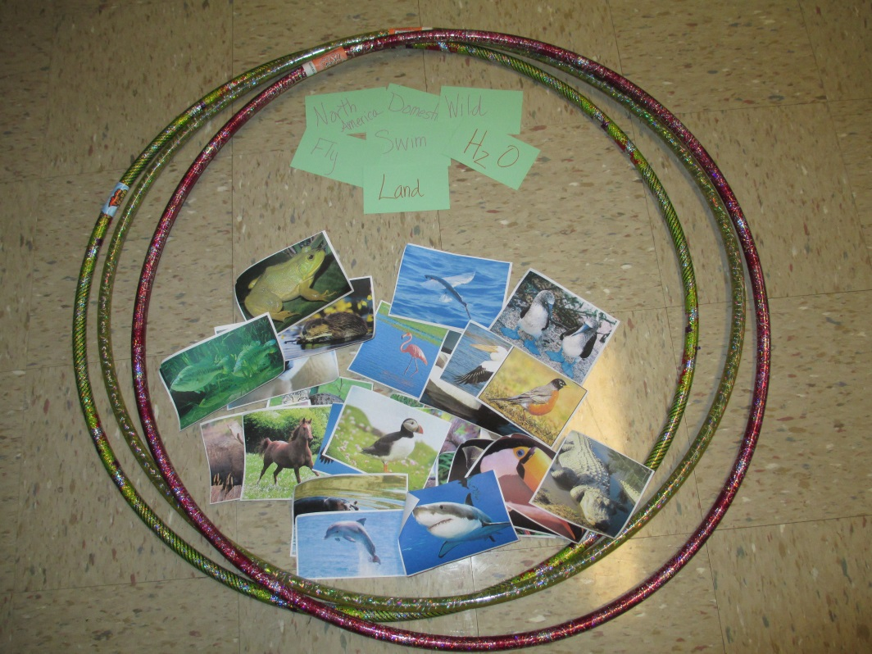
Materials Needed
3 Hula Hoops, Pictures of Animals, Labels for Hula Hoops

Slide 4
The Activity
Briefly Discuss the purpose of Venn Diagrams with the class.
Talk about Union and Intersection
Set up 2 of the hula hoops to make a Venn Diagram and lay out the animal pictures.

Slide 5
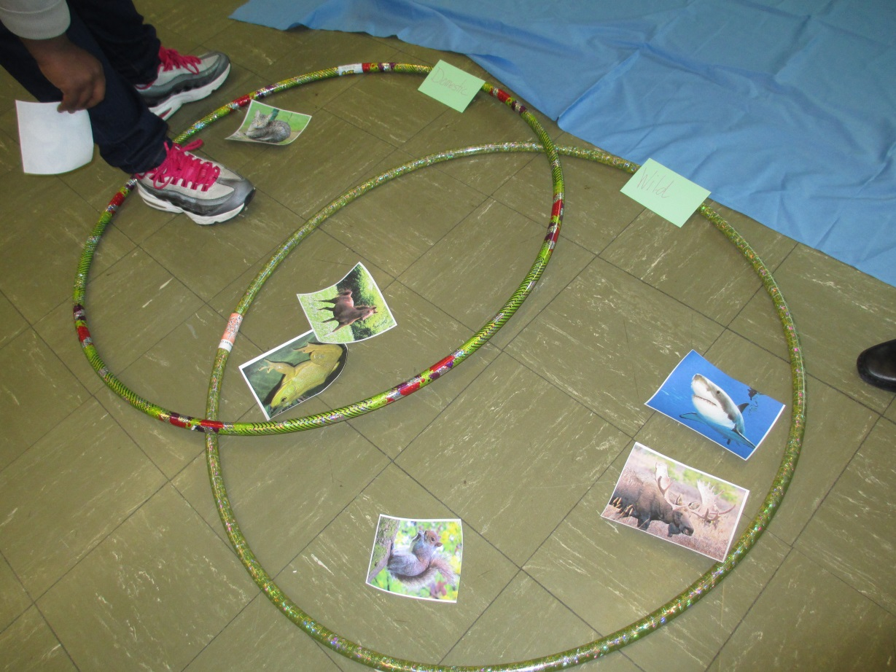
Activity Cont.
Students Take Turns Placing Animal Pictures into the correct section of the Venn Diagram

Slide 6
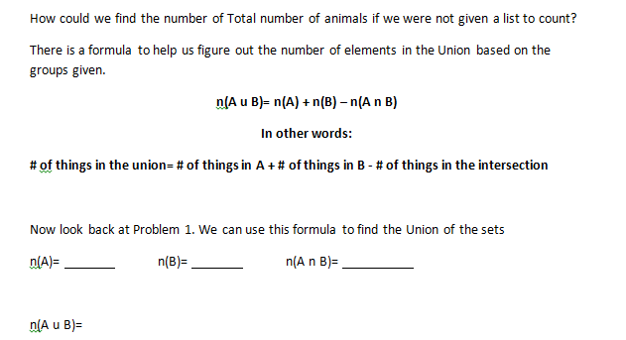
Activity Cont.
Have Students attempt to come up with the formula for Union on their own
Calculate the Union for the first Diagram
We did one more problem after the first one using only 2 sets

Slide 7
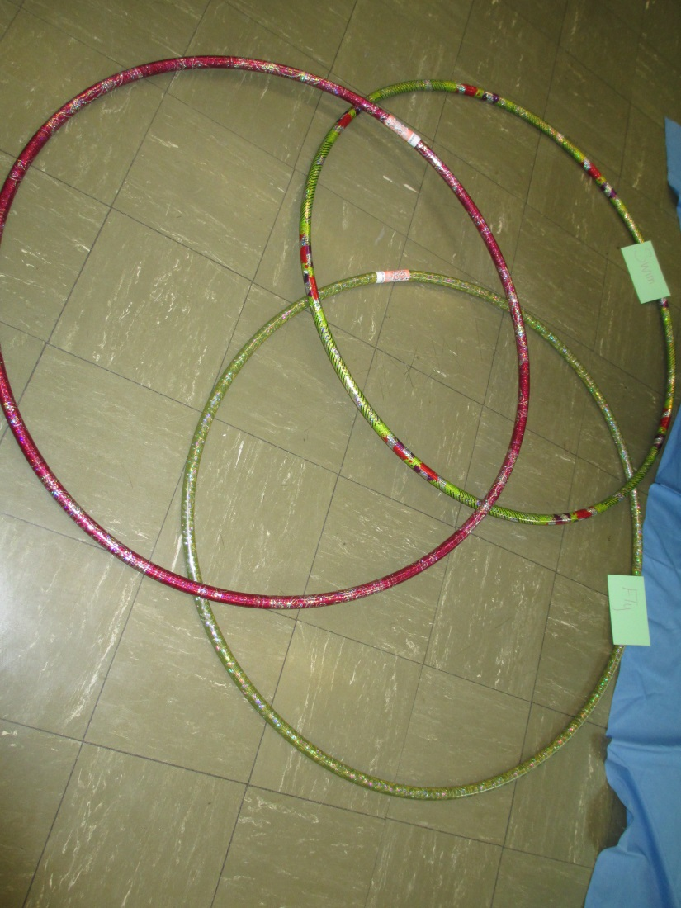
Activity Cont.
Discussed increasing the number of sets to 3 to create a 3 circle Venn Diagram.
Added Hula Hoop to the “diagram”

Slide 8
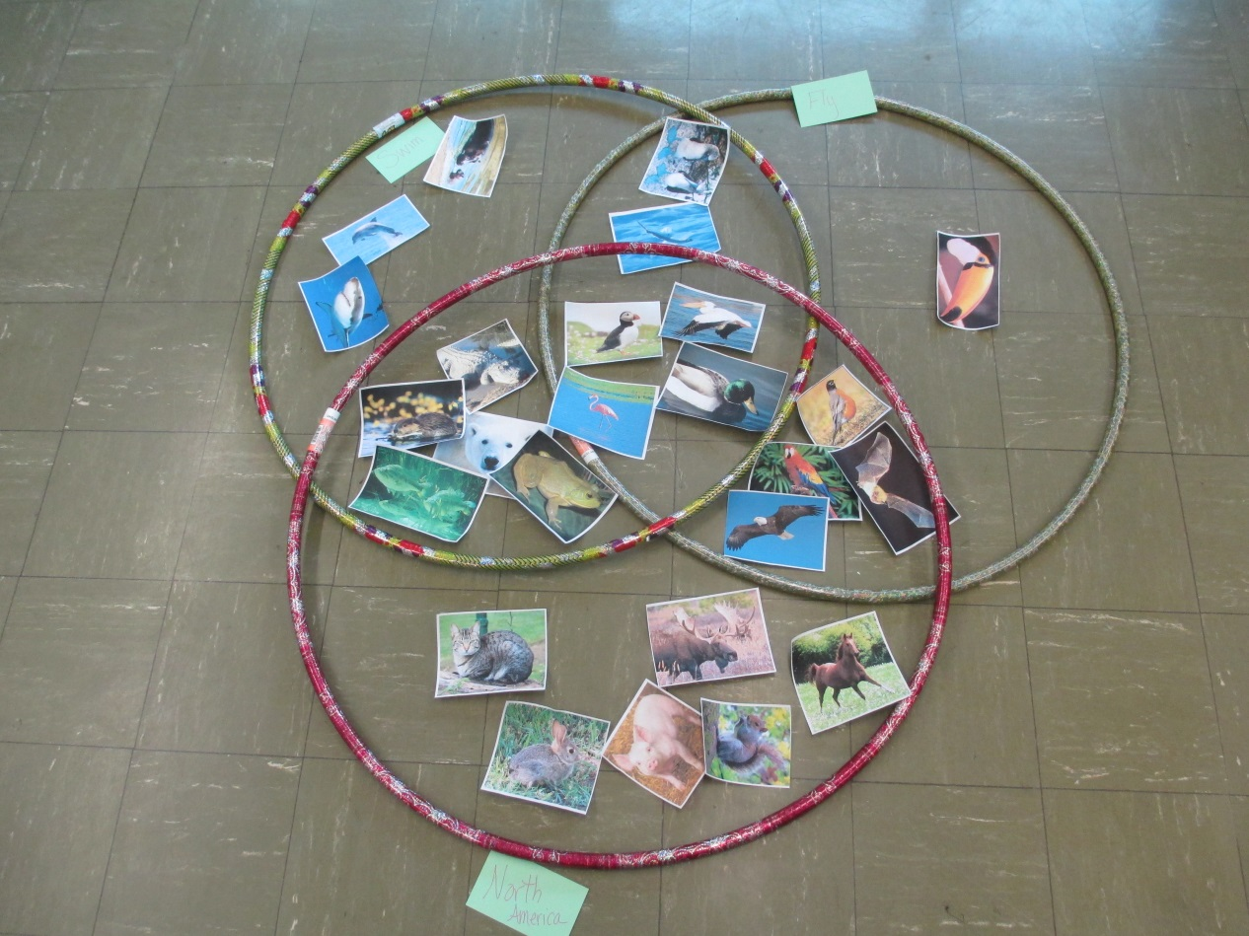
Activity Cont.
Help Students Place animals into the correct areas of the new Venn Diagram

Slide 9
Activity Cont.
Students now see how the original formula can be expanded to show the Union of not only two sets, but three.

Slide 10
Final Observations
The students had an easier time visualizing the intersections and sets because of the different colored hula hoops.
This class particularly enjoyed animals which made them very interactive. Changing the sets to target the students in the class could help make them interact more.
You could also use this activity for broader review. We did some probability review towards the end of the activity.

